Slide 1
3.5 Gradient Descent

Slide 2
In this Section we derive the gradient descent algorithm, building on our discussion of tangent hyperplanes in Section 3.4.

Slide 3
The gradient descent algorithm

Slide 4
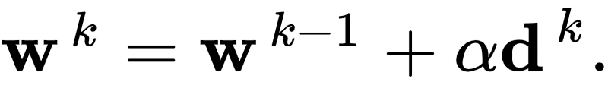
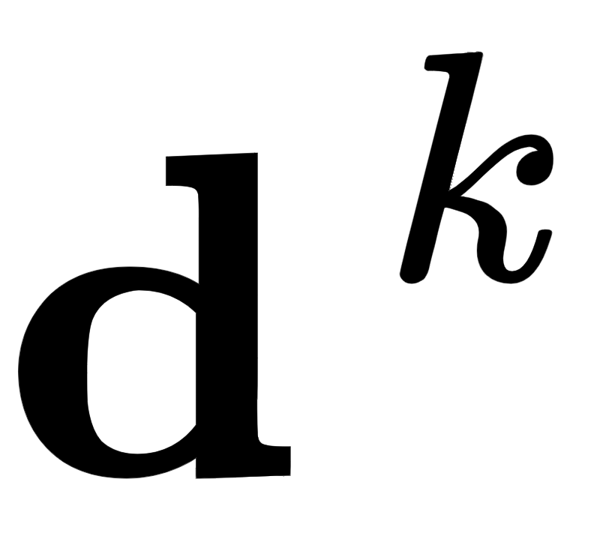

Remember, a general local optimization method looks like
Here are descent direction vectors and is called the steplength parameter.

Slide 5
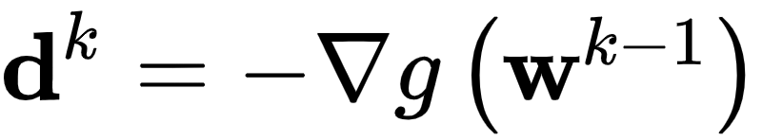

Given what we saw in Section 3.4 we could naturally ask what a local method employing the negative gradient direction at each step might look like, and how it might behave.
Setting the descent direction in the above formula, such a sequence of steps would then take the form
Because each and every direction is guaranteed to be one of descent, intuitively this seems like a potentially useful instance of local optimization.

Slide 6
Indeed this is precisely the gradient descent algorithm.
It is it called gradient descent - in employing the (negative) gradient as our descent direction - we are repeatedly descending in the (negative) gradient direction at each step.

Slide 7
Appreciate the power of this descent direction - which is almost literally given to us - over the zero-order methods detailed in the previous Chapter.
There we had to search to find a descent direction, here calculus provides us not only with a descent direction (without search), but an excellent one to boot.

Slide 8
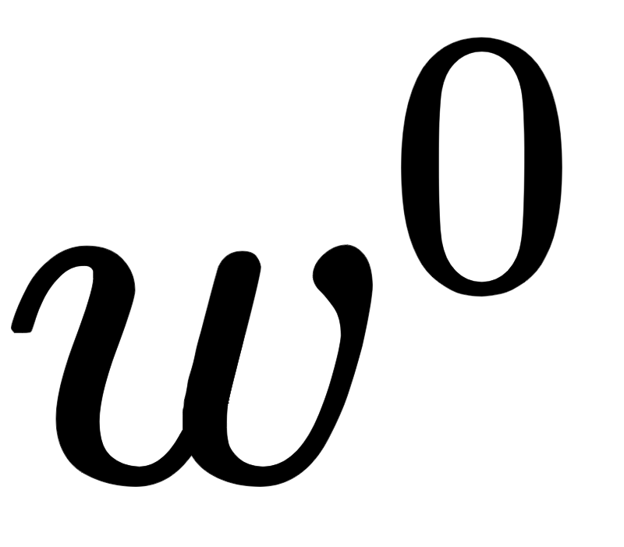
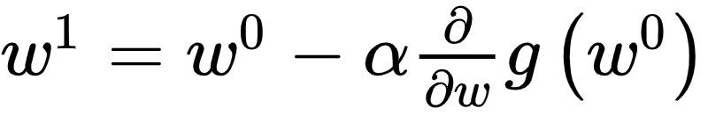
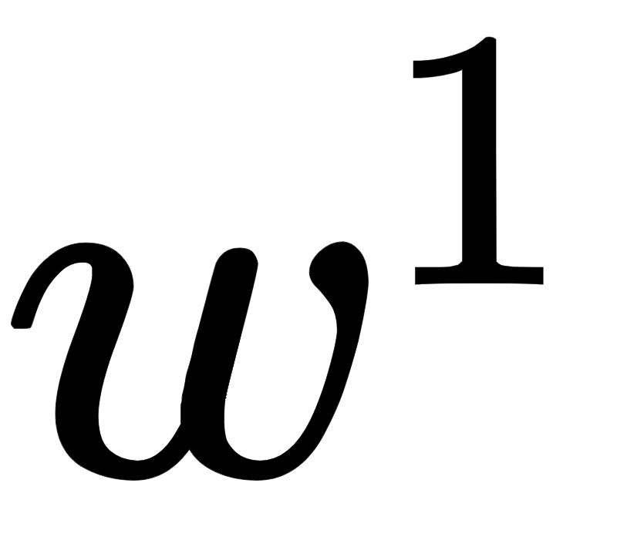
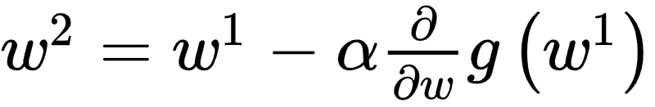
The path taken by gradient descent is illustrated figuratively below for a general single-input function.
Beginning at the point , we make our first approximation is drawn below as a red dot, with the first order Taylor series approximation drawn in green.
Moving in the negative gradient descent direction provided by this approximation we arrive at a point
We then repeat this process at , moving in the negative gradient direction there, to , and so forth.

Slide 9
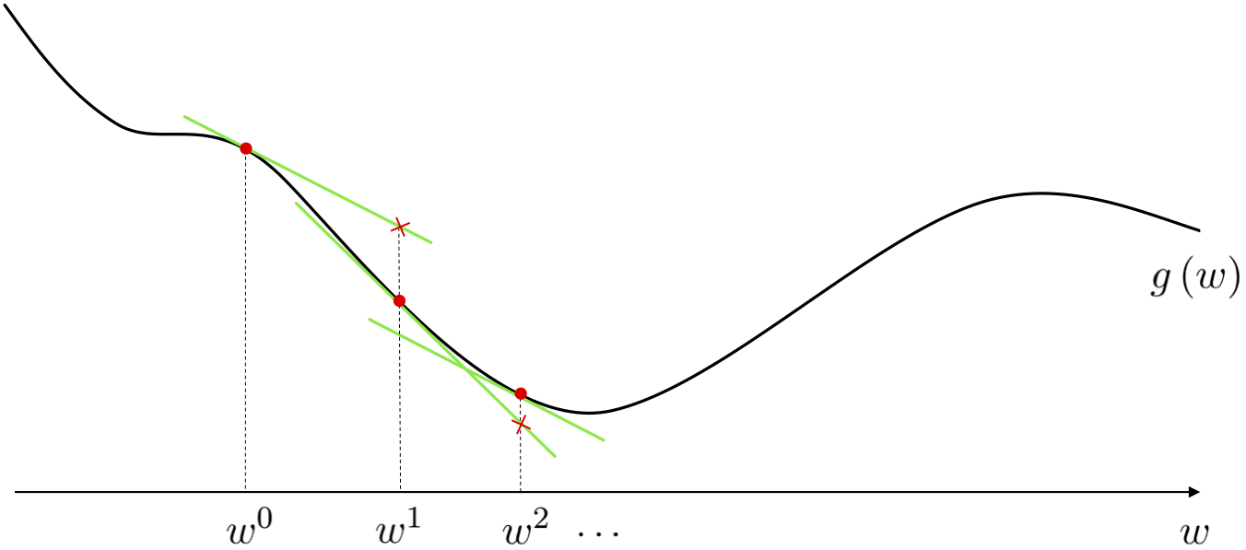

Slide 10
Often gradient descent is far better than the zero order approaches discussed in the previous Chapter
This is entirely due to the fact that the descent direction here - provided by calculus via the gradient - is universally easier to compute.

Slide 11
Below we provide the generic pseudo-code and ``Python`` implementation of the gradient descent algorithm which will be used in a variety of examples that follow in this Section.

Slide 12
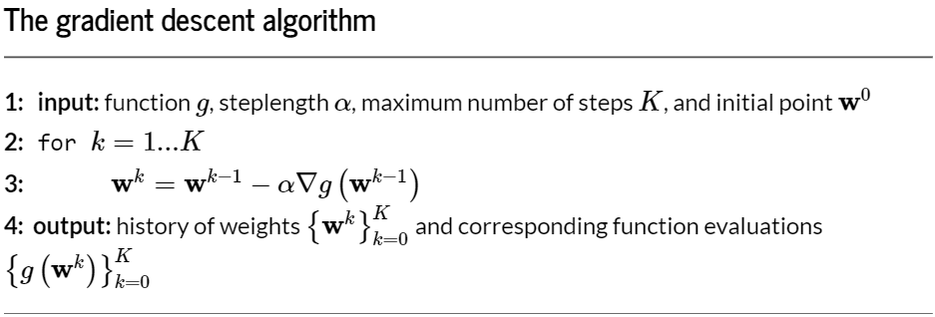

Slide 13
How do we set the parameter in general?
There are many ways for choosing for local optimization (as first discussed in Chapter 2) basic (and most commonly used).
Indeed popular approaches are precisely those introduced in the (comparatively simpler) context of zero order methods in Section 2.3: that is fixed and diminishing steplegnth choices. We explore this idea further in a subsection below.

Slide 14
When does gradient descent stop?
Technically (when is chosen well) the algorithm will halt near stationary points of a function, typically minima or saddle points.
How do we know this? By the very form of the gradient descent step itself.

Slide 15
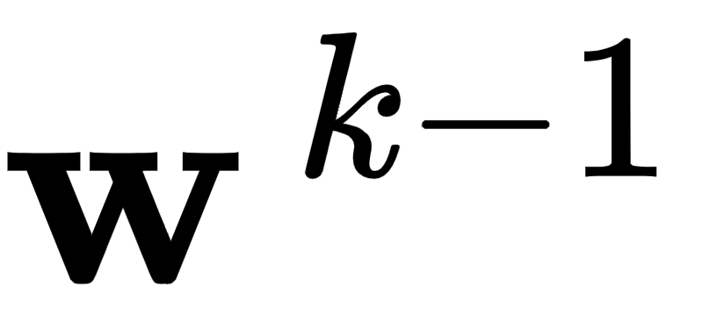
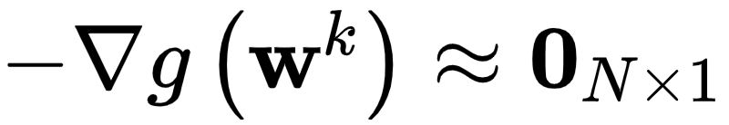
Say the step
does not move from the prior point significantly.
Then this can mean only one thing: that the direction we are traveling in is vanishing i.e.,
This is - by definition - a *stationary point* of the function.

Slide 16
A generic ``Python`` implementation of the gradient descent algorithm

Slide 17
Below we implement gradient descent as described above.
It involves just a few requisite initializations, the computation of the gradient function via e.g., an Automatic Differentiator, and the very simple ``for`` loop.
The output is a history of the weights and corresponding cost function values at each step of the gradient descent algorithm.

Slide 18
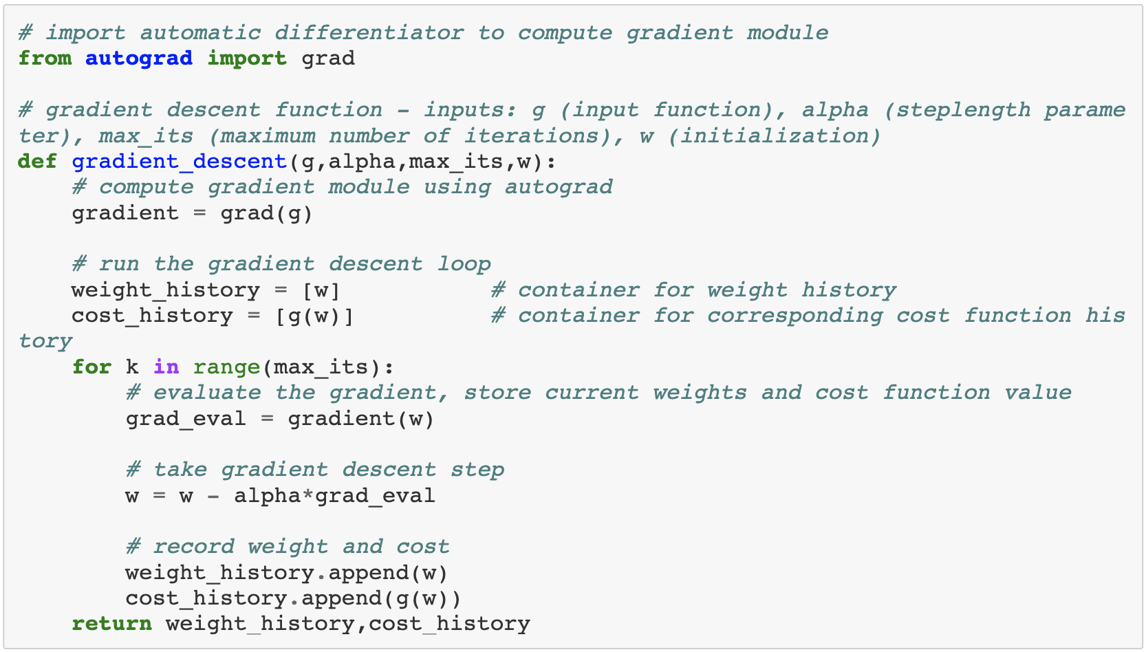

Slide 19
Given the input to g is N dimensional a general random initialization - the kind that is often used - can be written as shown below.
Here the function `random.randn` produces samples from a standard Normal distribution with mean zero and unit standard deviation. It is also common to scale such initializations by small constants like e.g., 0.1.

Slide 21
Example: A convex single input example

Slide 22

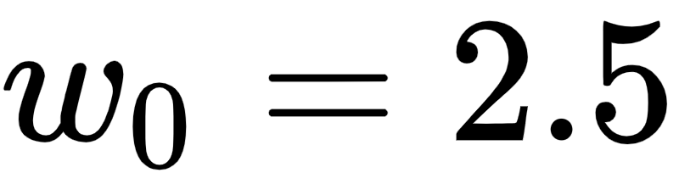
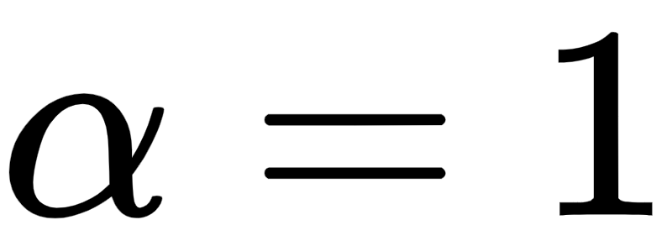
Below we animate the use of gradient descent to minimize the polynomial function
Here and

Slide 23
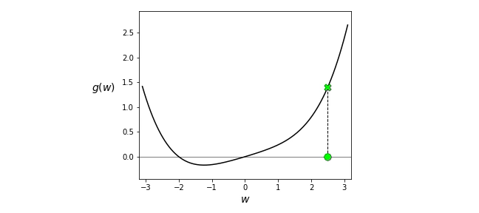

Slide 24
Example: A non-convex single input example

Slide 25
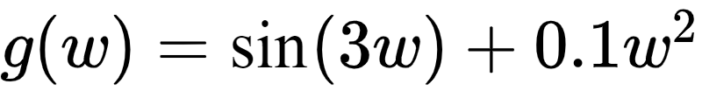
Now we show the result of running gradient descent several times to minimize the function
For general non-convex functions like this one, several runs (of any local optimization method) can be necessary to determine points near global minima.

Slide 26
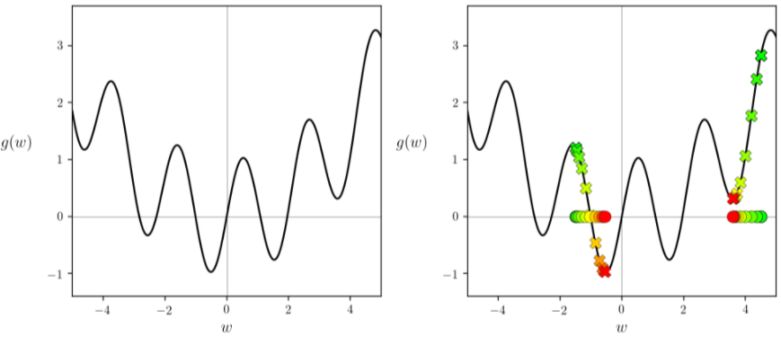

Slide 27
Viewing the cost function history plot allows us to view the progress of gradient descent, regardless of the function's input dimension.

Slide 28
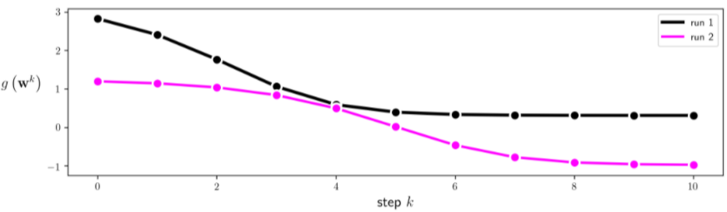

Slide 29
As discussed in the prior Chapter, these plots are a valuable debugging tool, as well as a valuable tool for selecting proper values for the steplength

Slide 30
Example: An example of fixed steplength selection for a single input convex function

Slide 31
At each step of gradient descent we always have a descent direction - this is defined explicitly by the negative gradient itself.
However whether or not we descend in the function when taking this step depends completely on how far along it we travel, on our choice of the steplength parameter.
We illustrate this general principle in the animation below, using 5 steps of gradient descent.

Slide 32
